Slide 1
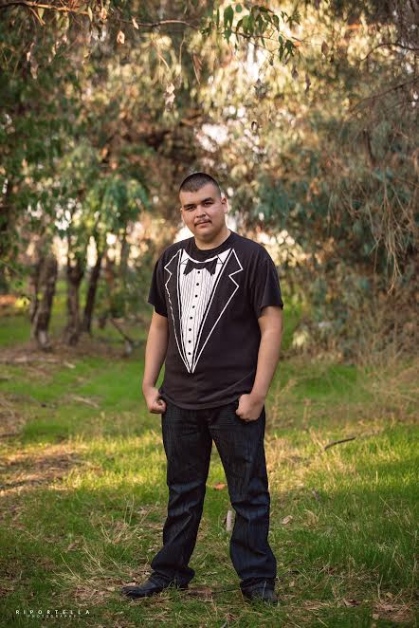
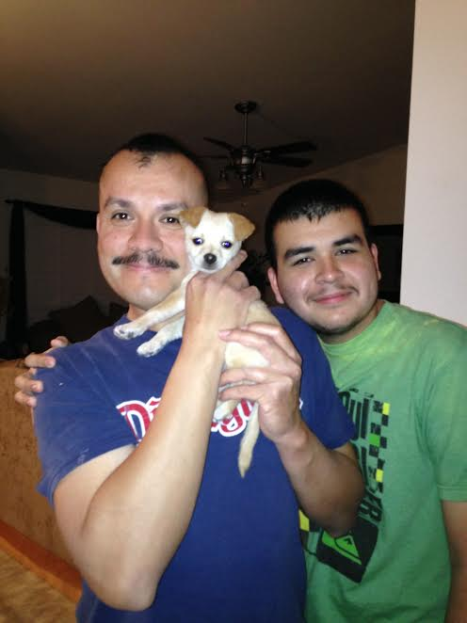
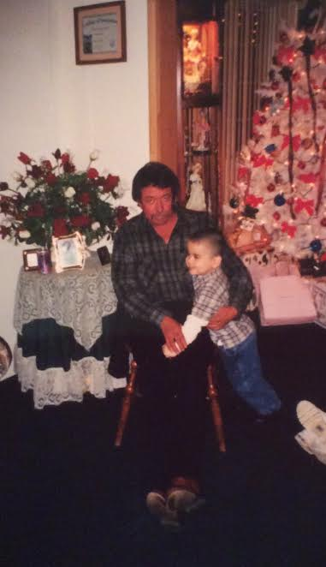
Eric Esquivel

Slide 2
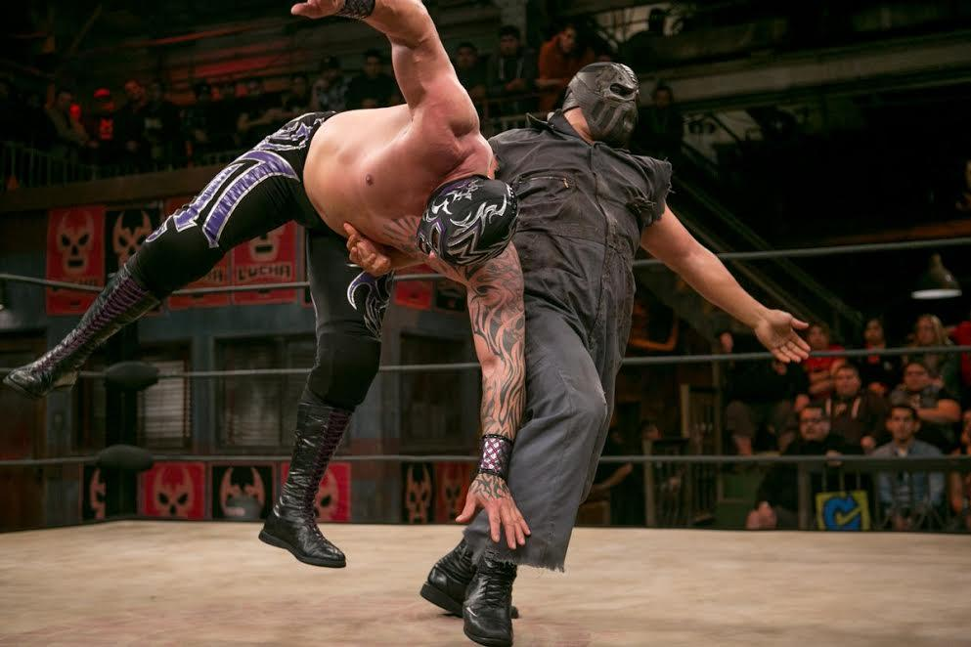
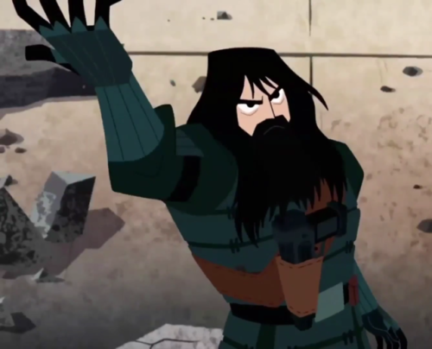
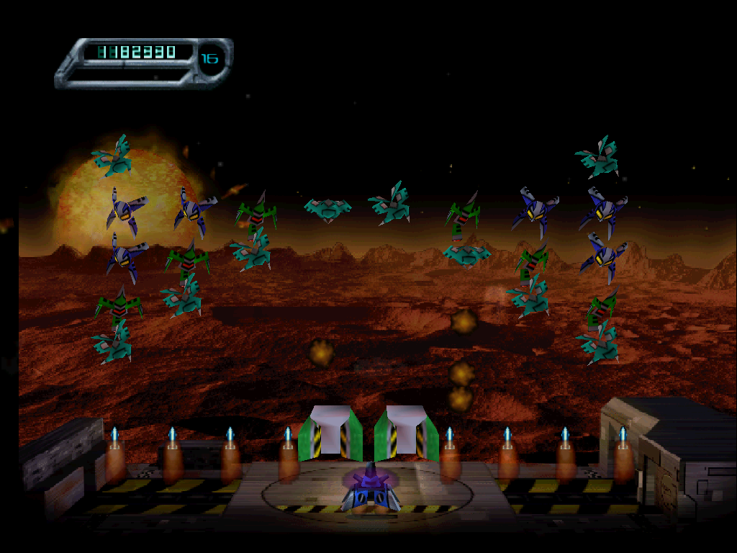
About Me
I was born in Lindsay california in 1999 i have lived here my whole life
I’m an only Child and i enjoy it
I love playing vidoes games and watching my favorite shows because it helps me escape the daily stresses of life

Slide 3
High School Experience
I’ve been apart of both anime and gaming club
I’ve been apart of anime club for 2 years and been in gaming club for this year
I Like going because I get to hangout with my friends and talk about things that interest me
Someone of my challenges in high school was dealing with procrastination

Slide 4
Job Shadow
Job shadowed Mr.Umphres an art LF
Always would have liked to have a career in the art industry
It was interesting because I got to see it what it was like in his daily life
The thing I remember most about the job shadow is when we got from classroom to classroom
Hope to see myself drawing or animating

Slide 5
Pathway
For I pathway I chose drama
Also had art as an open pathway
Chose drama because I love to act and enetertain
Hope to be acting as voice actor

Slide 6
Future
Plain on stay local not ready to leave my family
Attend COS for 2 years
I hope to start my career as an actor after I graduate COS

Slide 7
Leaving LHS
I’m sad to leave LHS but also happy
Had lots of fun the past 4 years
Made a lot of news friends
Got into a lot of new things
Learned to be myself around my friends

Slide 8
Any Questions?

